Slide 1
ART2 vs. ARTMAP: Parkinson’s Disease Classification from Biomedical Voice Measurements
By: Michael J. Suggs
Computer Science Undergraduate
University of North Carolina Wilmington

Slide 2
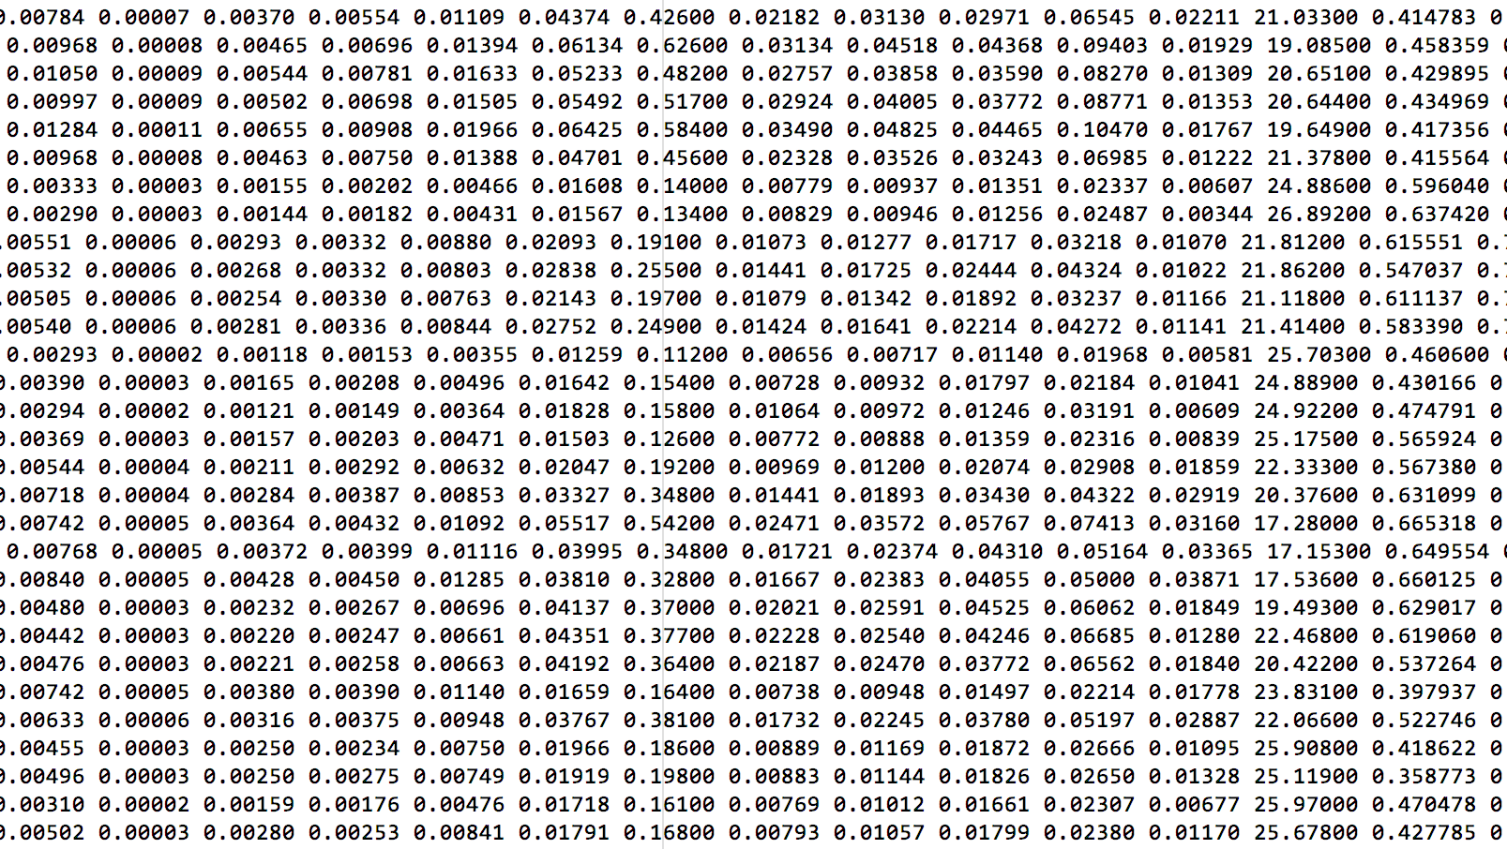
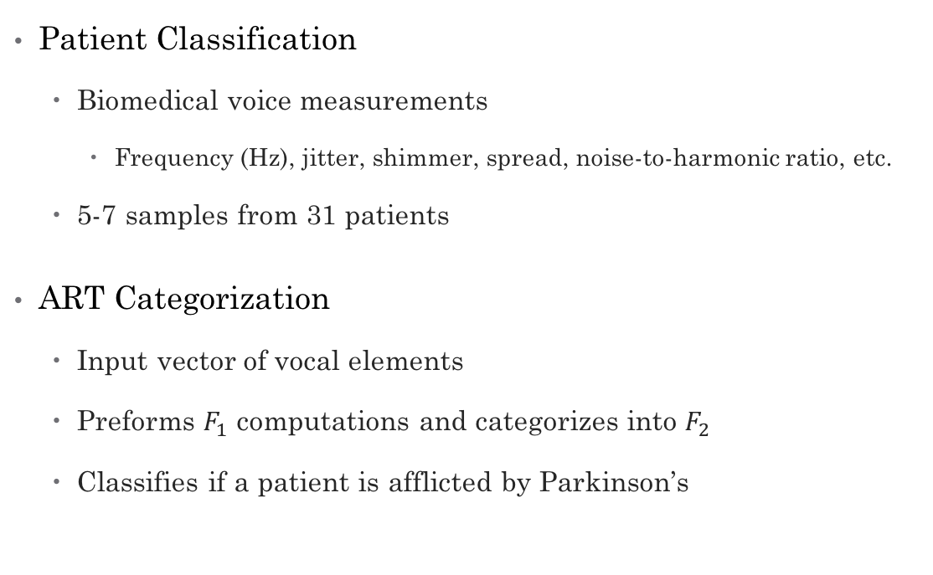
Experiment Overview
Patient Classification
Biomedical voice measurements
Frequency (Hz), jitter, shimmer, spread, noise-to-harmonic ratio, etc.
5-7 samples from 31 patients
ART Categorization
Input vector of vocal elements
Preforms $F_{1}$ computations and categorizes into $F_{2}$
Classifies if a patient is afflicted by Parkinson’s

Slide 3
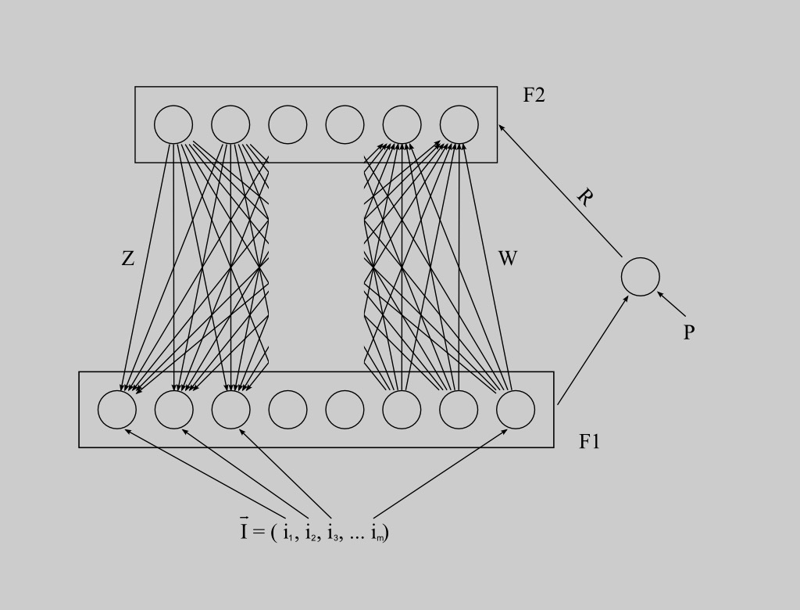
Adaptive Resonance Theory
What is ART?
Unsupervised learning algorithm (with supervised variants)
Classifies each input vector into a category
ART Varieties
ART1: Binary inputs
ART2: Continuous inputs
ART3: Neurochemical modeled
Fuzzy ART: Fuzzy logic
ARTMAP Varieties
ARTMAP: Binary or continuous inputs
Fuzzy ARTMAP: Fuzzy logic

Slide 4
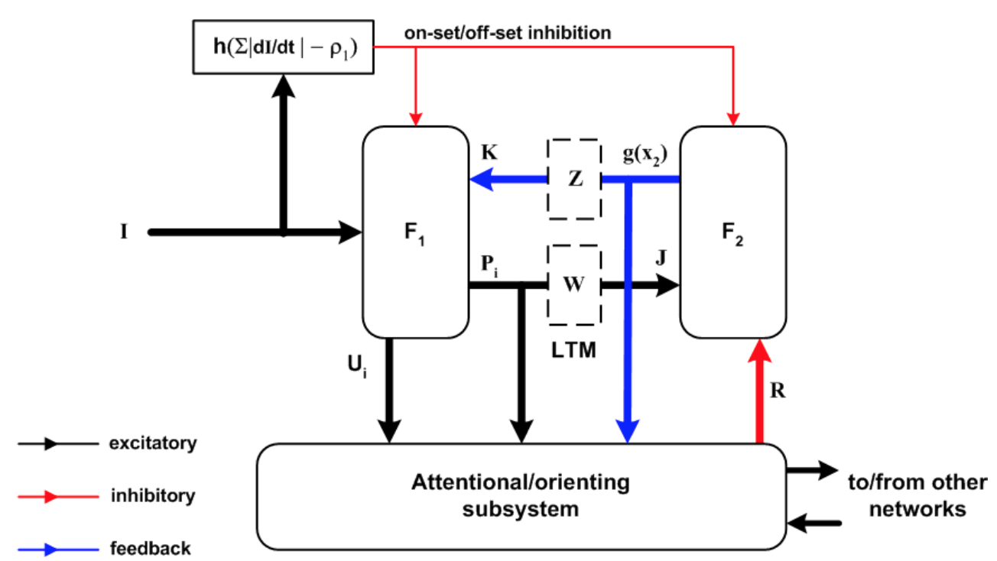
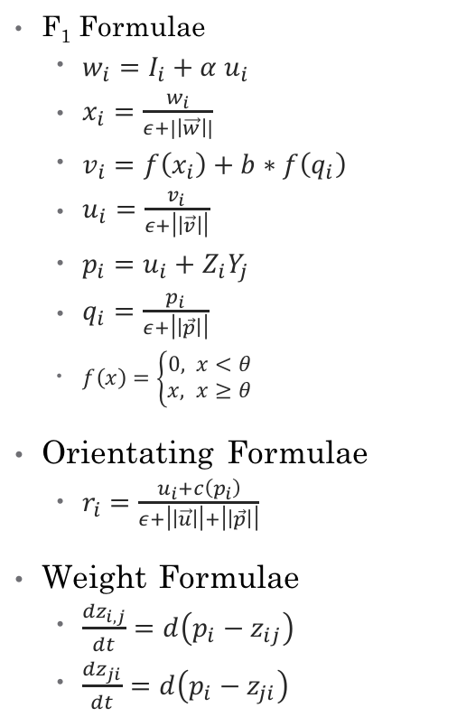
ART2 Overview
F₁ Formulae
$w_{i}=I_{i}+{α u}_{i}$
$x_{i}=\frac{w_{i}}{ε+|\left|\vec{w}\right||}$
$v_{i}=f\left(x_{i}\right)+b∗f\left(q_{i}\right)$
$u_{i}=\frac{v_{i}}{ε+\left|\left|\vec{v}\right|\right|}$
$p_{i}=u_{i}+Z_{i}Y_{j}$
$q_{i}=\frac{p_{i}}{ε+\left|\left|\vec{p}\right|\right|}$
$f\left(x\right)=\left\{\begin{aligned}0, x<θ \\ x, x≥θ\end{aligned}\right.$
Orientating Formulae
$r_{i}=\frac{u_{i}+c\left(p_{i}\right)}{ε+\left|\left|\vec{u}\right|\right|+\left|\left|\vec{p}\right|\right|}$
Weight Formulae
$\frac{dz_{i,j}}{dt}=d\left(p_{i}−z_{ij}\right)$
$\frac{dz_{ji}}{dt}=d\left(p_{i}−z_{ji}\right)$

Slide 5
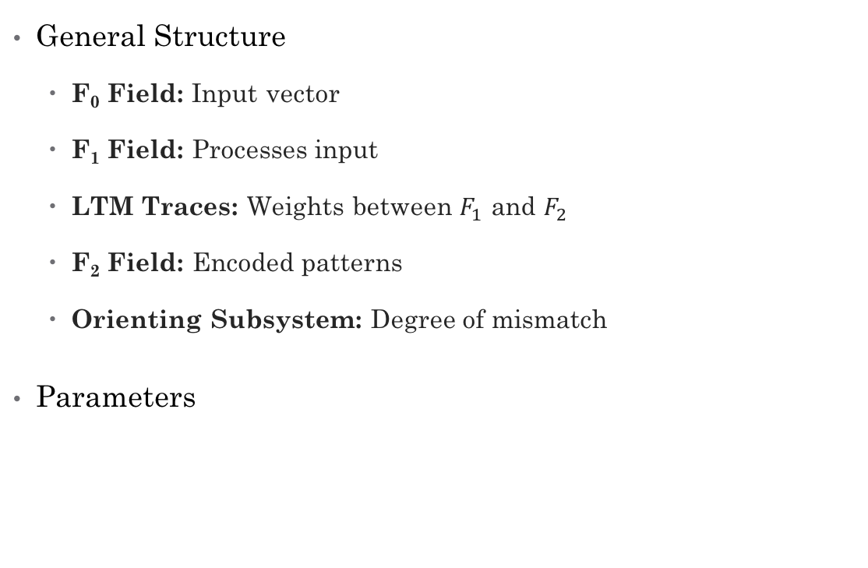
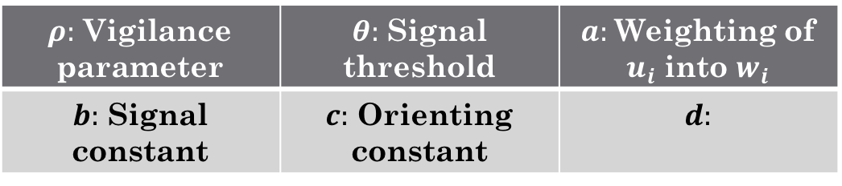
Adaptive Resonance Theory
General Structure
F₀ Field: Input vector
F₁ Field: Processes input
LTM Traces: Weights between $F_{1}$ and $F_{2}$
F₂ Field: Encoded patterns
Orienting Subsystem: Degree of mismatch
Parameters
$ρ:$ Vigilance parameter | $θ:$ Signal threshold | $a:$ Weighting of $u_{i}$ into $w_{i}$
$b:$ Signal constant | $c:$ Orienting constant | $d:$

Slide 6
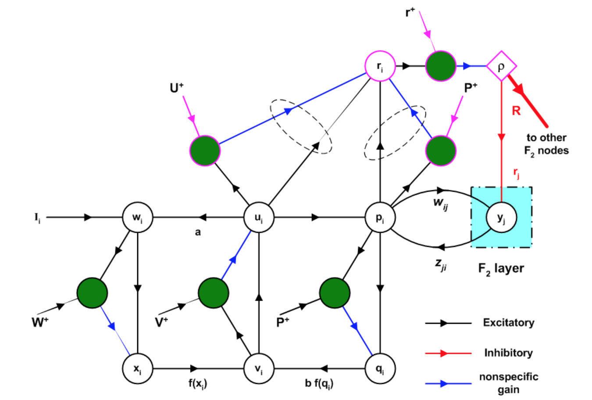
ART2 Overview
F₁ Formulae
$w_{i}=I_{i}+{α u}_{i}$
$x_{i}=\frac{w_{i}}{ε+|\left|\vec{w}\right||}$
$v_{i}=f\left(x_{i}\right)+b∗f\left(q_{i}\right)$
$u_{i}=\frac{v_{i}}{ε+\left|\left|\vec{v}\right|\right|}$
$p_{i}=u_{i}+Z_{i}Y_{j}$
$q_{i}=\frac{p_{i}}{ε+\left|\left|\vec{p}\right|\right|}$
$f\left(x\right)=\left\{\begin{aligned}0, x<θ \\ x, x≥θ\end{aligned}\right.$
Orientating Formulae
$r_{i}=\frac{u_{i}+c\left(p_{i}\right)}{ε+\left|\left|\vec{u}\right|\right|+\left|\left|\vec{p}\right|\right|}$
Weight Formulae
$\frac{dz_{i,j}}{dt}=d\left(p_{i}−z_{ij}\right)$
$\frac{dz_{ji}}{dt}=d\left(p_{i}−z_{ji}\right)$

Slide 7
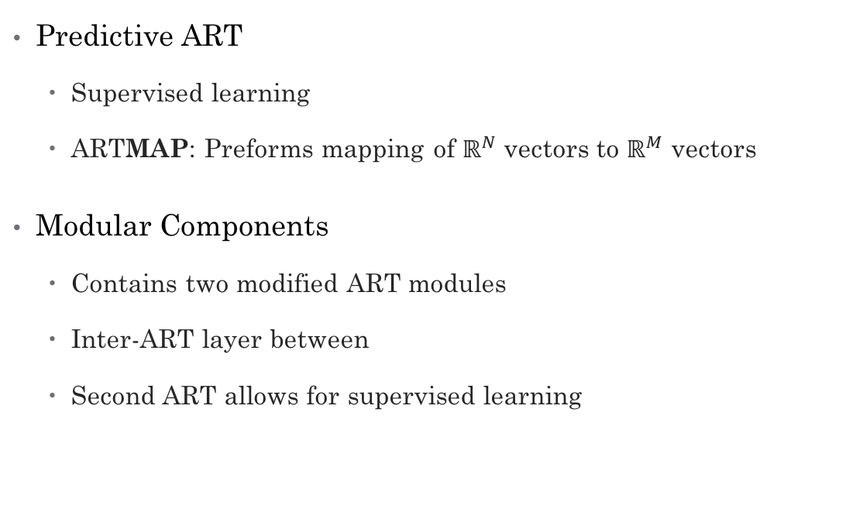
ARTMAP
Predictive ART
Supervised learning
ARTMAP: Preforms mapping of $ℝ^{N}$ vectors to $ℝ^{M}$ vectors
Modular Components
Contains two modified ART modules
Inter-ART layer between
Second ART allows for supervised learning

Slide 8
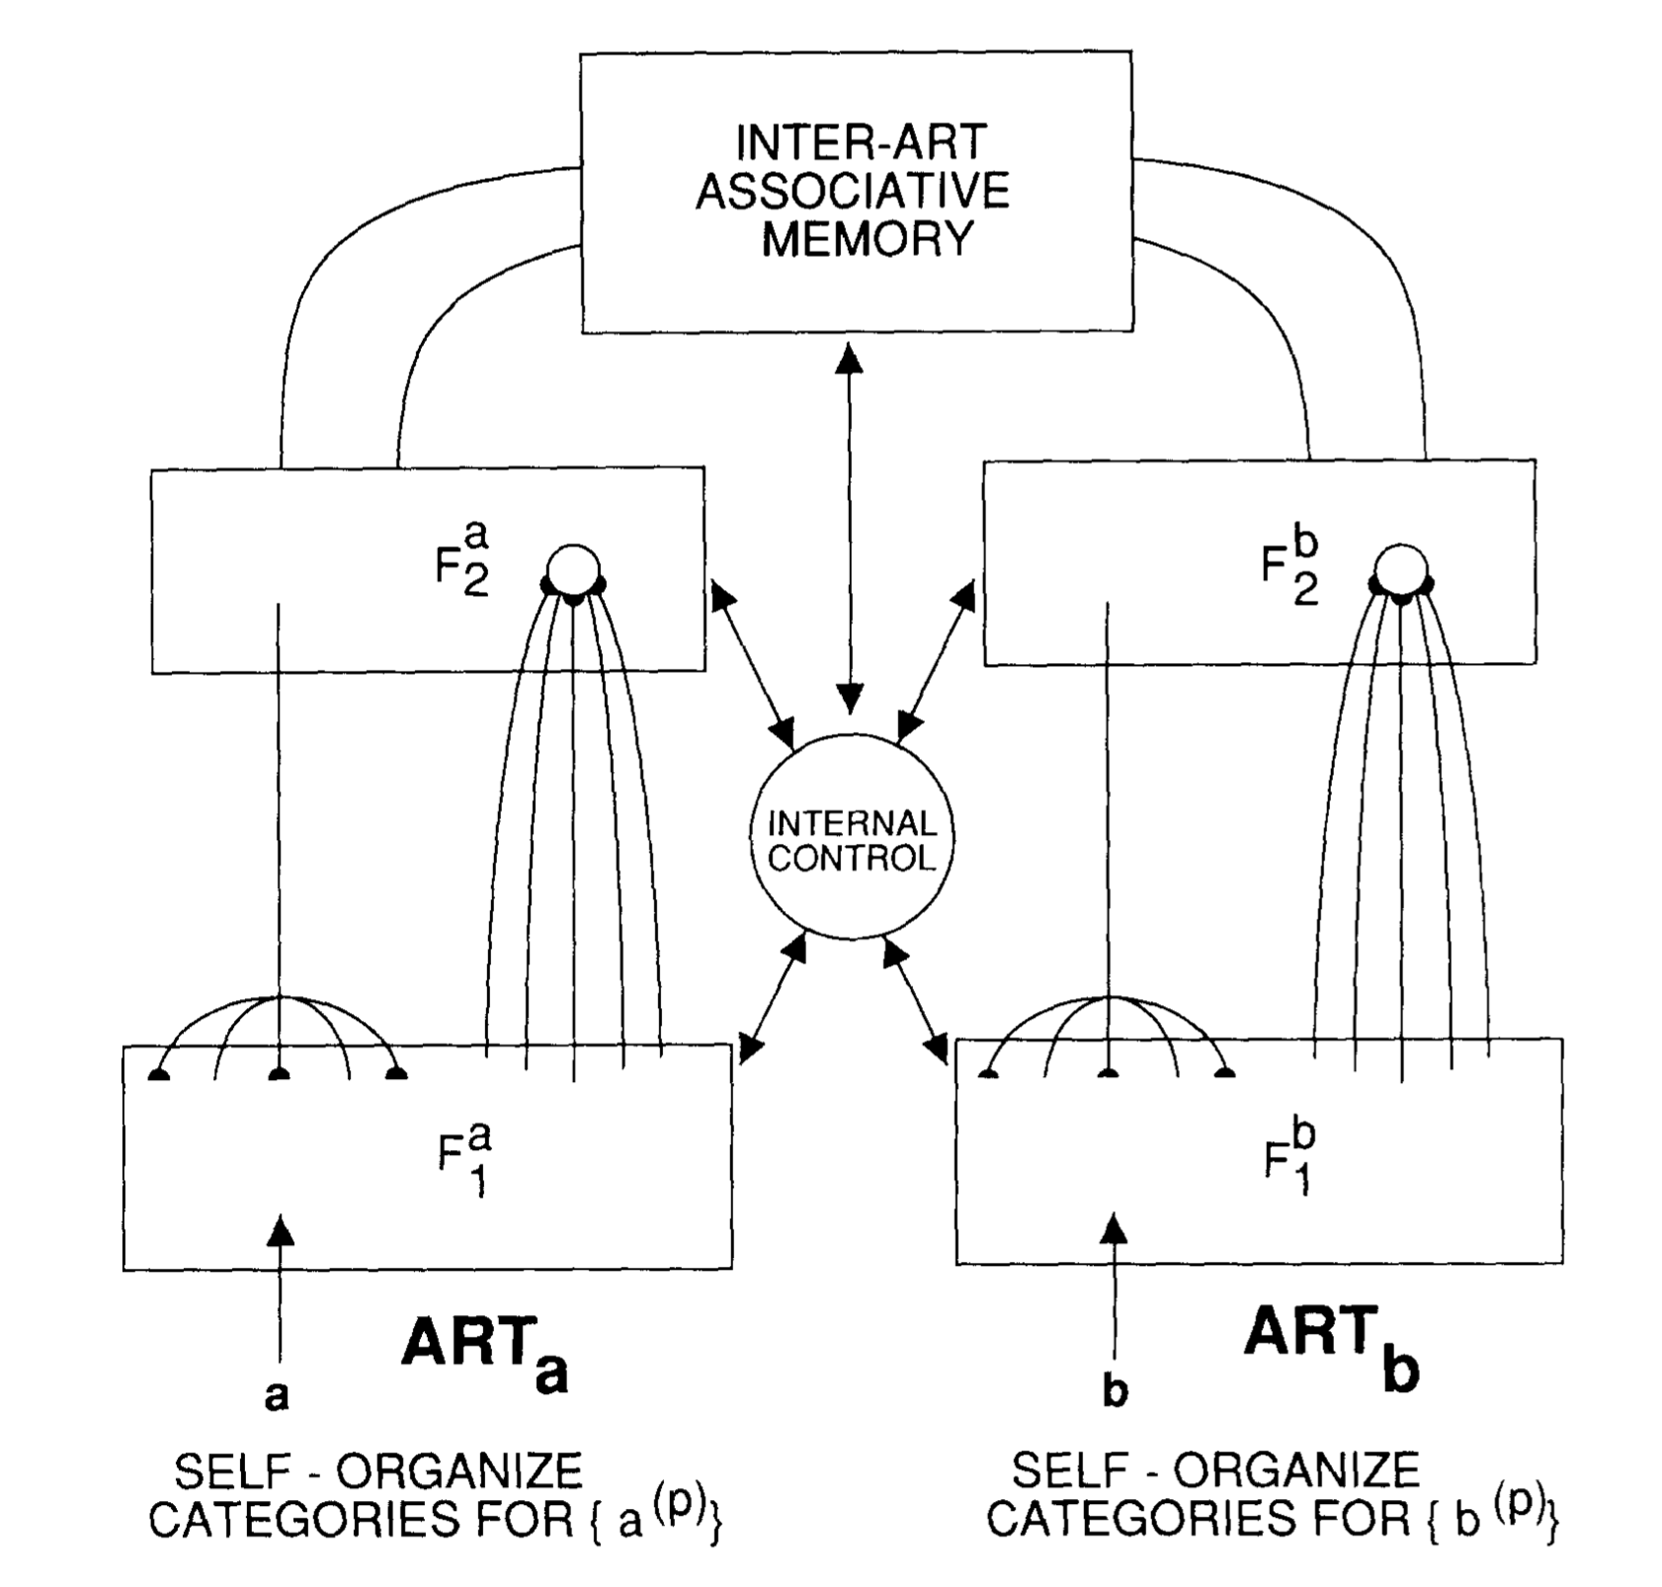
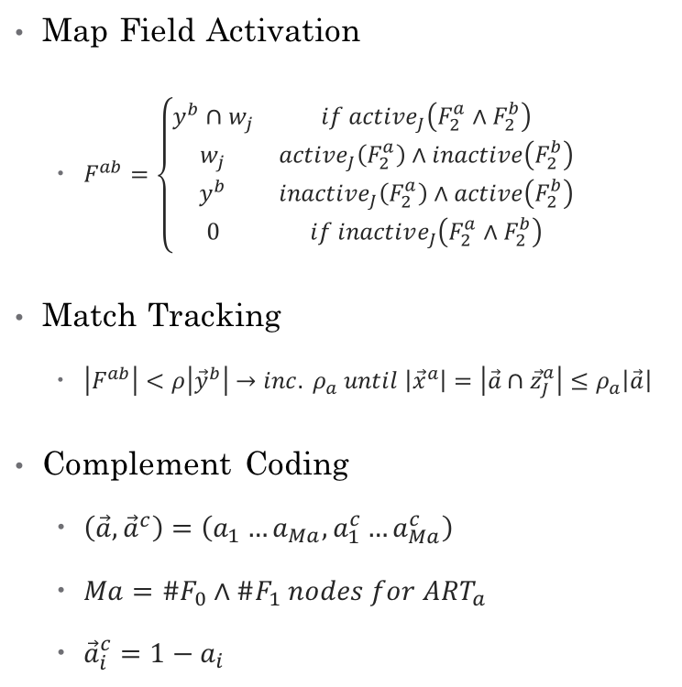
ARTMAP
Map Field Activation
$F^{ab}=\left\{\begin{aligned}\begin{matrix}y^{b}∩w_{j} & if active_{J}\left(F_{2}^{a}∧F_{2}^{b}\right) \\ w_{j} & active_{J}\left(F_{2}^{a}\right)∧inactive\left(F_{2}^{b}\right) \\ y^{b} & inactive_{J}\left(F_{2}^{a}\right)∧active\left(F_{2}^{b}\right) \\ 0 & if inactive_{J}\left(F_{2}^{a}∧F_{2}^{b}\right)\end{matrix}\end{aligned}\right.$
Match Tracking
$\left|F^{ab}\right|<ρ\left|{\vec{y}}^{b}\right|→inc. ρ_{a} until \left|{\vec{x}}^{a}\right|=\left|\vec{a}∩{\vec{z}}_{J}^{a}\right|≤ρ_{a}\left|\vec{a}\right|$
Complement Coding
$\left(\vec{a},{\vec{a}}^{c}\right)=\left(a_{1}…a_{Ma}, a_{1}^{c}…a_{Ma}^{c}\right)$
$Ma=\#F_{0}∧\#F_{1} nodes for ART_{a}$
${\vec{a}}_{i}^{c}=1−a_{i}$

Slide 9
ARTMAP
Structure
Two ART modules
Inter-ART layer
Map Field Gain Control
Map Field
Map Field Orienting Subsystem
Inter-ART
Has own vigilance
Resembles back propagation
Does not actually back propagate; reorganizes groupings

Slide 10
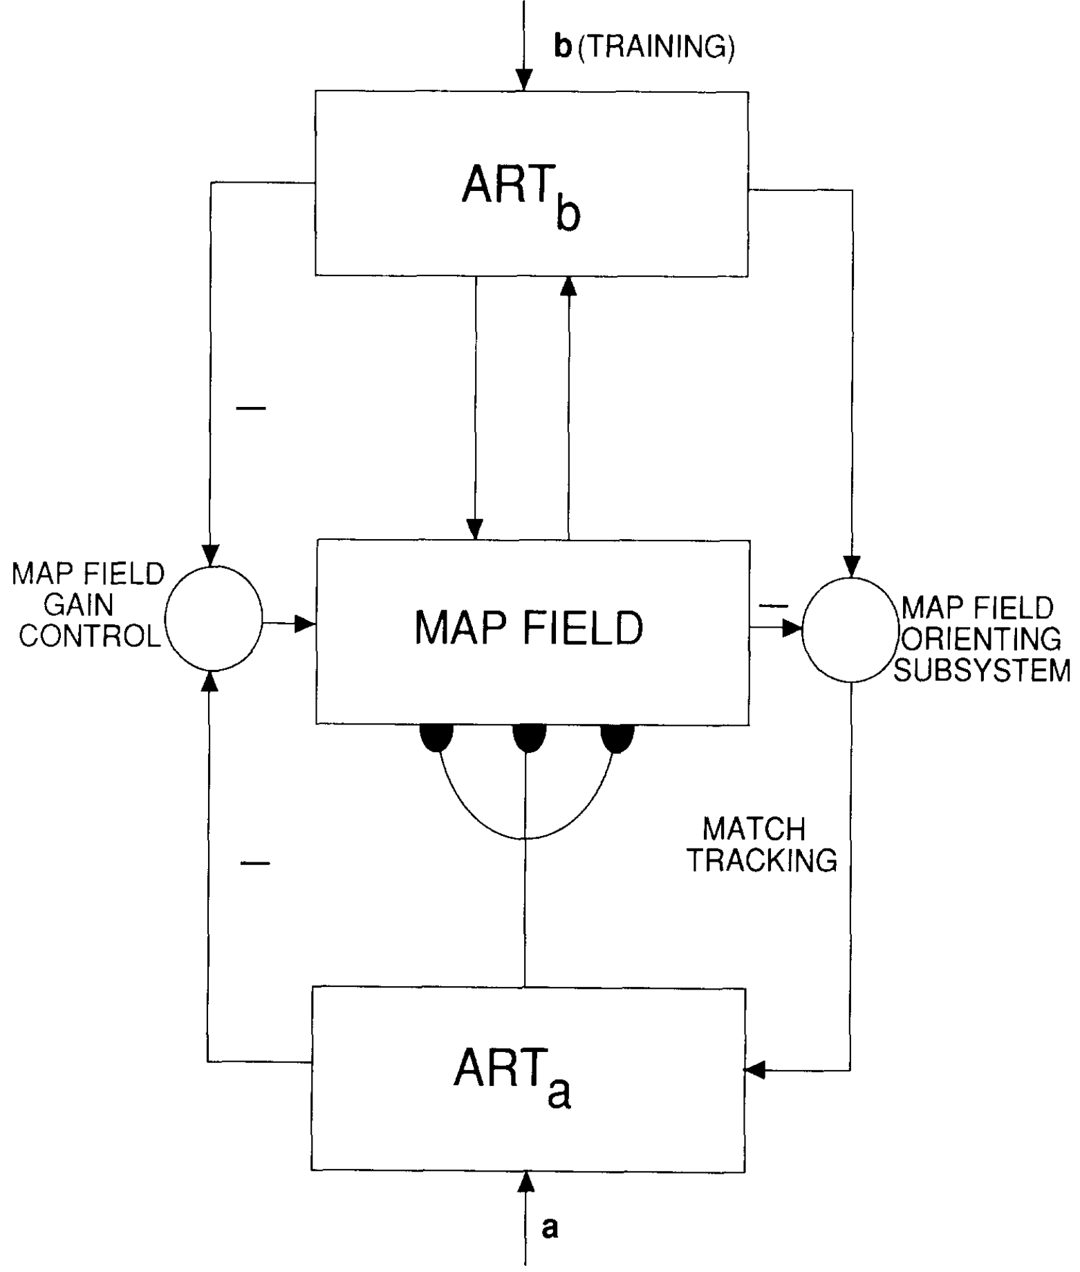
ARTMAP
Map Field Activation
$F^{ab}=\left\{\begin{aligned}\begin{matrix}y^{b}∩w_{j} & if active_{J}\left(F_{2}^{a}∧F_{2}^{b}\right) \\ w_{j} & active_{J}\left(F_{2}^{a}\right)∧inactive\left(F_{2}^{b}\right) \\ y^{b} & inactive_{J}\left(F_{2}^{a}\right)∧active\left(F_{2}^{b}\right) \\ 0 & if inactive_{J}\left(F_{2}^{a}∧F_{2}^{b}\right)\end{matrix}\end{aligned}\right.$
Match Tracking
$\left|F^{ab}\right|<ρ\left|{\vec{y}}^{b}\right|→inc. ρ_{a} until \left|{\vec{x}}^{a}\right|=\left|\vec{a}∩{\vec{z}}_{J}^{a}\right|≤ρ_{a}\left|\vec{a}\right|$
Complement Coding
$\left(\vec{a},{\vec{a}}^{c}\right)=\left(a_{1}…a_{Ma}, a_{1}^{c}…a_{Ma}^{c}\right)$
$Ma=\#F_{0}∧\#F_{1} nodes for ART_{a}$
${\vec{a}}_{i}^{c}=1−a_{i}$

Slide 11
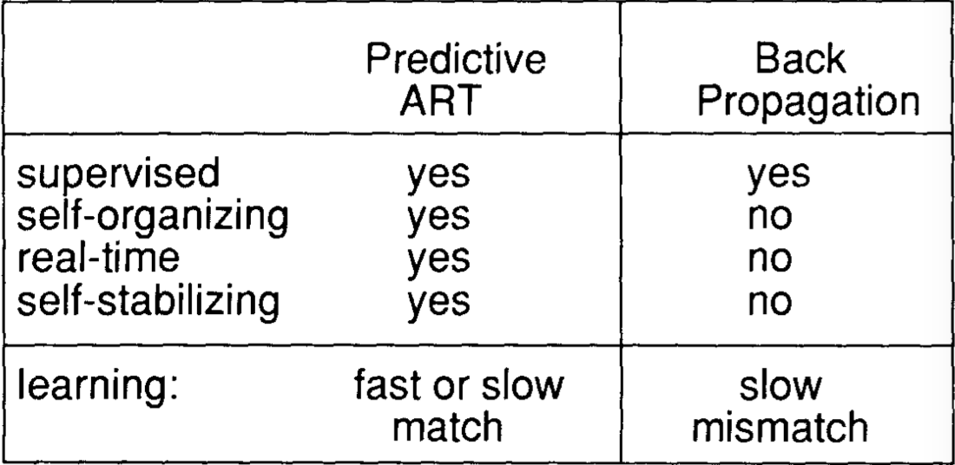
ARTMAP Back Prop. Comparison

Slide 12
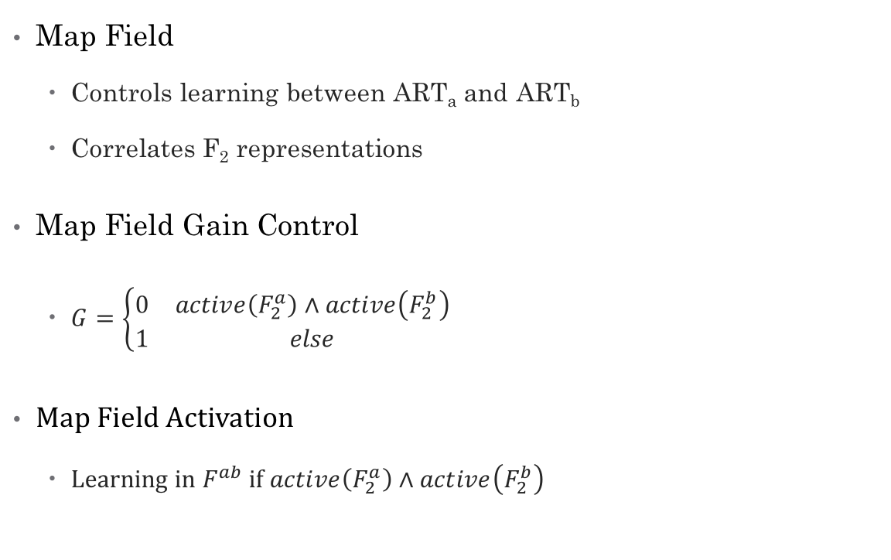
ARTMAP
Map Field
Controls learning between ART_{a} and ART_{b}
Correlates F₂ representations
Map Field Gain Control
$G=\left\{\begin{aligned}\begin{matrix}0 & active\left(F_{2}^{a}\right)∧active\left(F_{2}^{b}\right) \\ 1 & else\end{matrix}\end{aligned}\right.$
Map Field Activation
Learning in $F^{ab}$ if $active\left(F_{2}^{a}\right)∧active\left(F_{2}^{b}\right)$

Slide 13
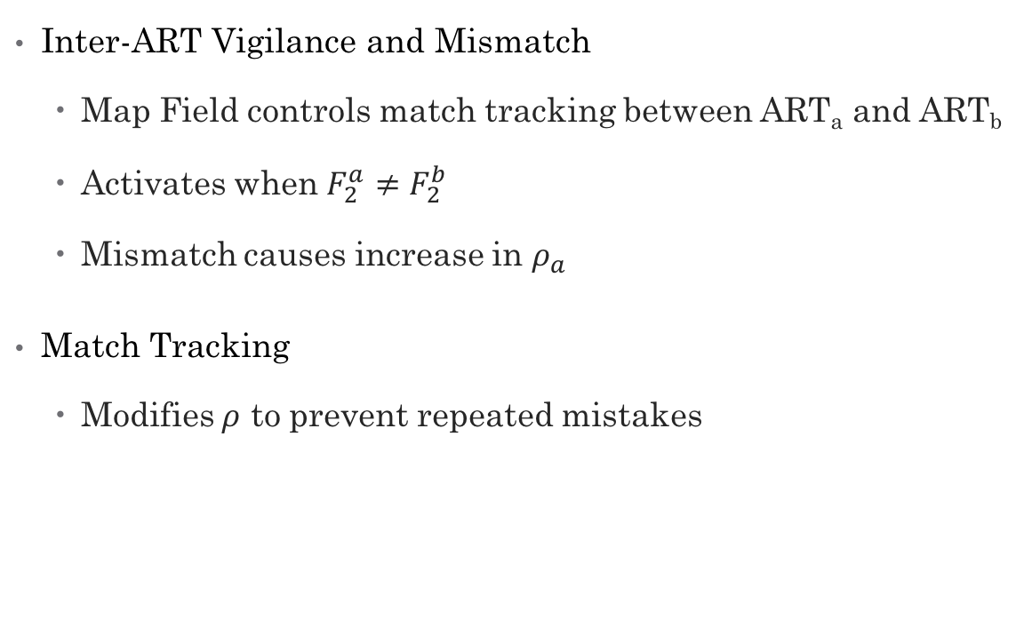
ARTMAP
Inter-ART Vigilance and Mismatch
Map Field controls match tracking between ART_{a} and ART_{b}
Activates when $F_{2}^{a}≠F_{2}^{b}$
Mismatch causes increase in $ρ_{a}$
Match Tracking
Modifies $ρ$ to prevent repeated mistakes

Slide 14
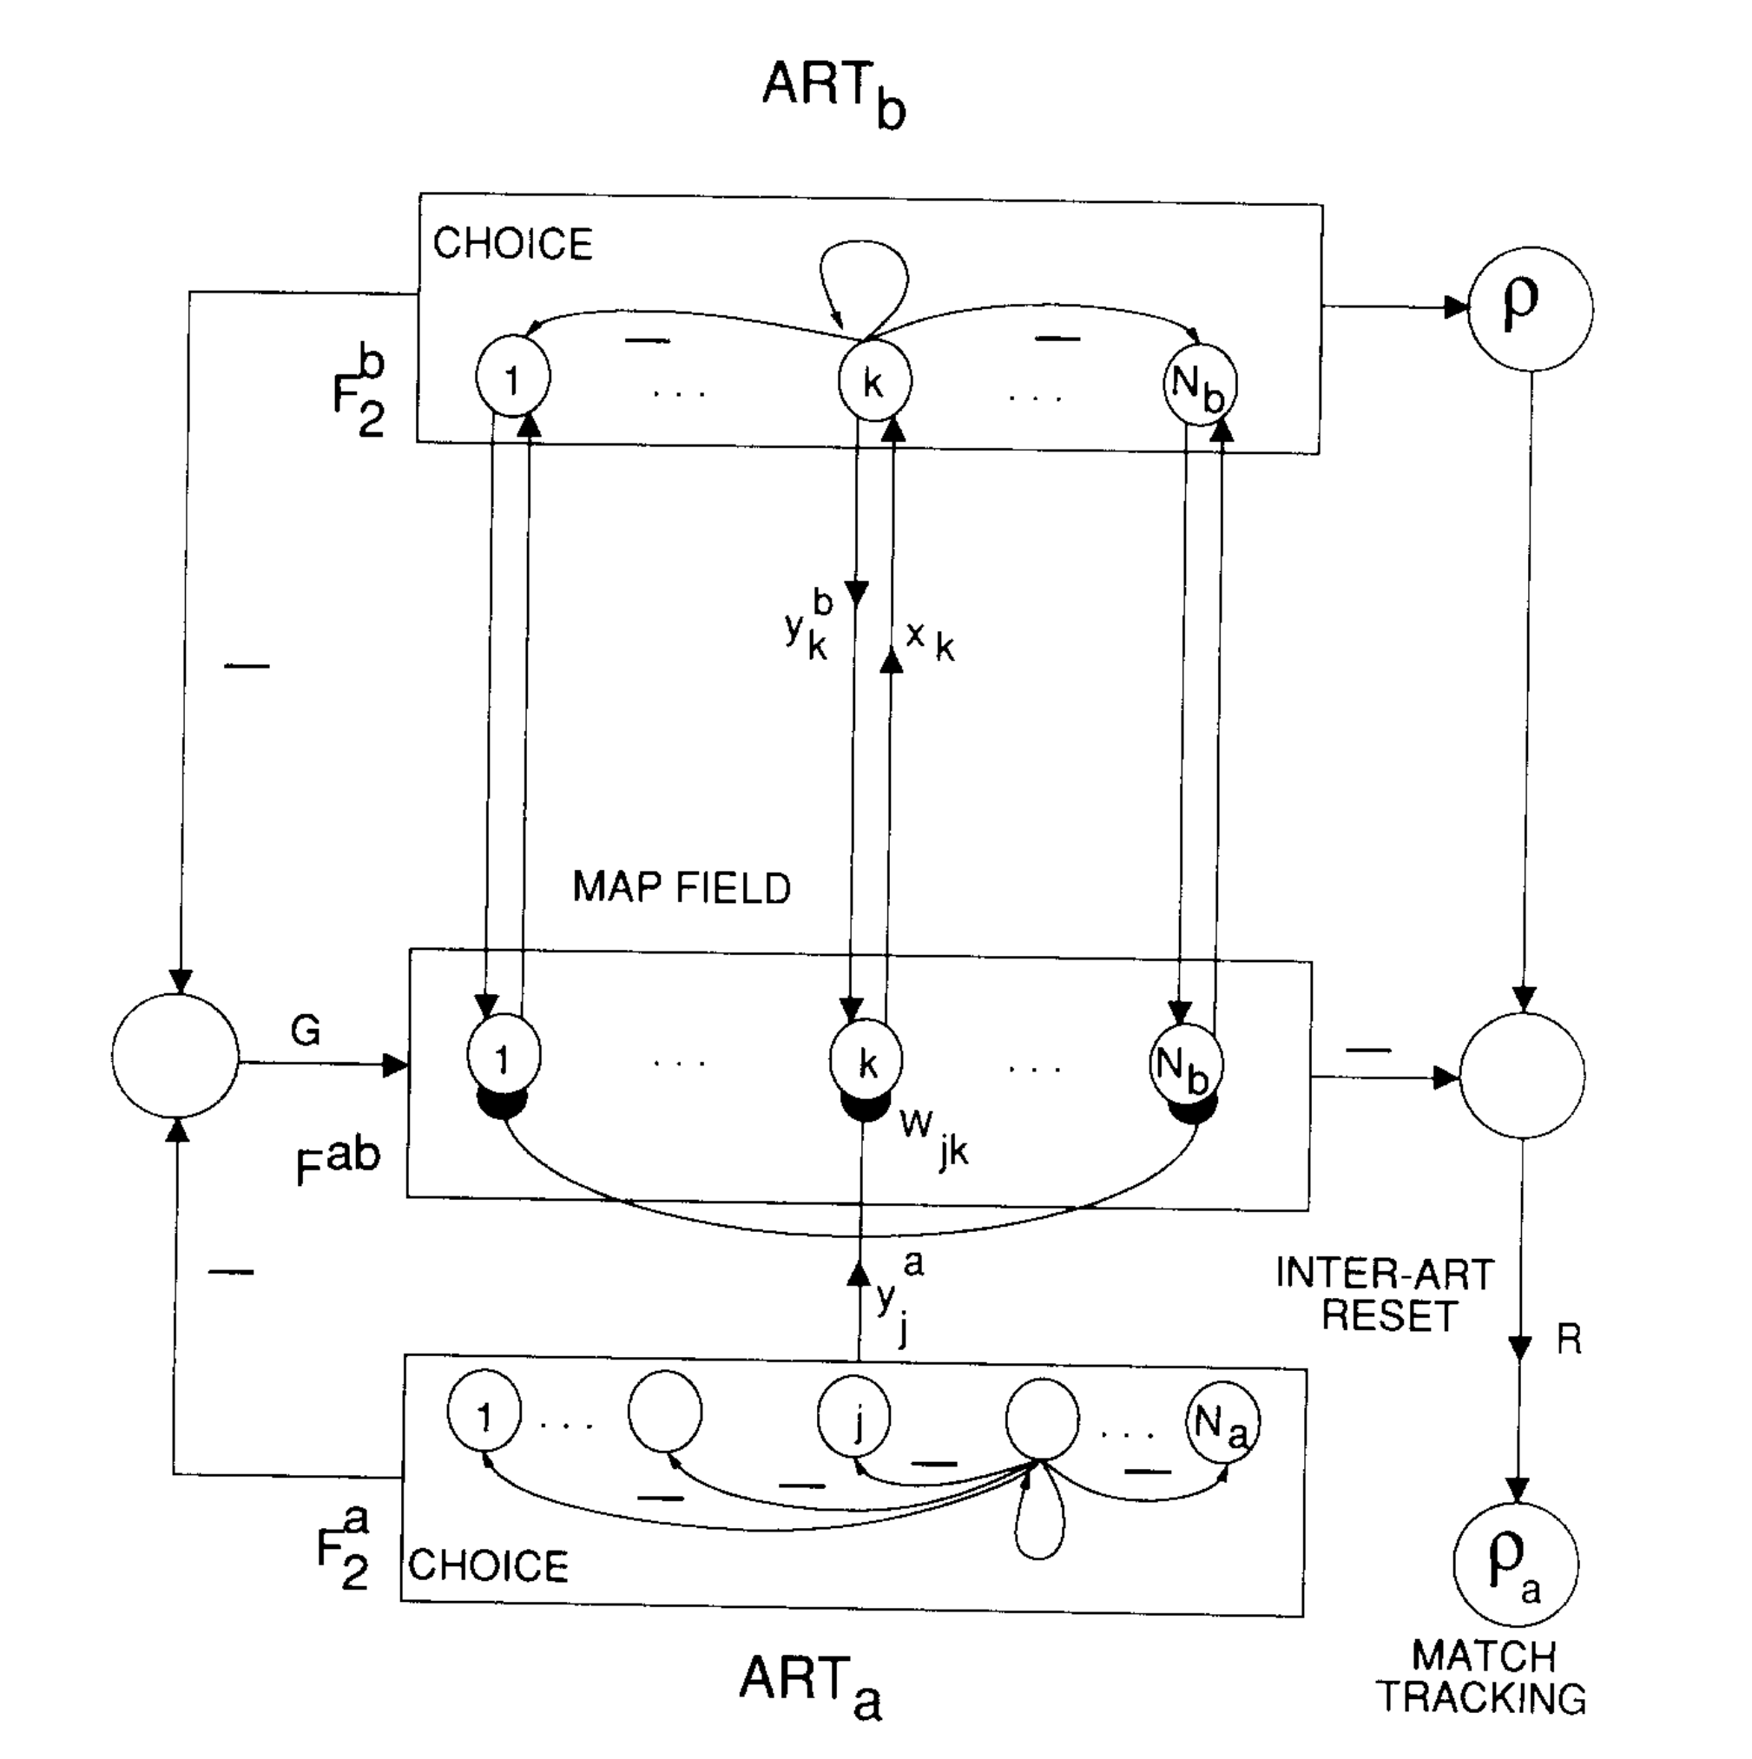
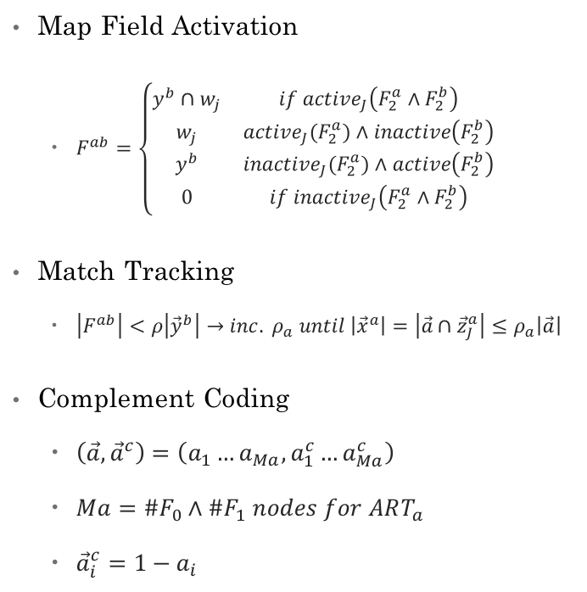
Map Field
Map Field Activation
$F^{ab}=\left\{\begin{aligned}\begin{matrix}y^{b}∩w_{j} & if active_{J}\left(F_{2}^{a}∧F_{2}^{b}\right) \\ w_{j} & active_{J}\left(F_{2}^{a}\right)∧inactive\left(F_{2}^{b}\right) \\ y^{b} & inactive_{J}\left(F_{2}^{a}\right)∧active\left(F_{2}^{b}\right) \\ 0 & if inactive_{J}\left(F_{2}^{a}∧F_{2}^{b}\right)\end{matrix}\end{aligned}\right.$
Match Tracking
$\left|F^{ab}\right|<ρ\left|{\vec{y}}^{b}\right|→inc. ρ_{a} until \left|{\vec{x}}^{a}\right|=\left|\vec{a}∩{\vec{z}}_{J}^{a}\right|≤ρ_{a}\left|\vec{a}\right|$
Complement Coding
$\left(\vec{a},{\vec{a}}^{c}\right)=\left(a_{1}…a_{Ma}, a_{1}^{c}…a_{Ma}^{c}\right)$
$Ma=\#F_{0}∧\#F_{1} nodes for ART_{a}$
${\vec{a}}_{i}^{c}=1−a_{i}$

Slide 15
Experiment Details
Tested each network on its ability to classify patients
Biomedical voice measurements
31 different patients (23 with Parkinson’s)
Each patient gave 5-7 non-consecutive voice samples
Each sample contained 22 measurements
Sample categories:
Frequency (Hz)
Jitter
Shimmer
Spread
Noise-to-harmonic ratio

Slide 16
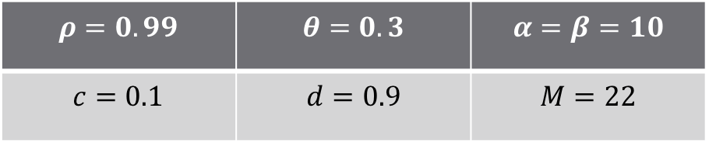
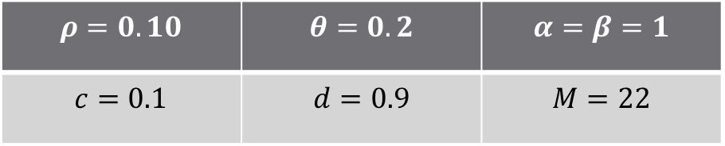
Experiment Parameters
ART2
ARTMAP
$$ρ=0.99$$ | $$θ=0.3$$ | $$α=β=10$$
$$c=0.1$$ | $$d=0.9$$ | $$M=22$$
$$ρ=0.10$$ | $$θ=0.2$$ | $$α=β=1$$
$$c=0.1$$ | $$d=0.9$$ | $$M=22$$

Slide 17
Experiment Parameters
MDVP: Fo(Hz)
Average vocal fundamental frequency
MDVP: Fhi(Hz)
Maximum vocal fundamental frequency
MDVP: Flo(Hz)
Minimum vocal fundamental frequency
MDVP: Jitter(%), Jitter(Abs), RAP, PPQ, Jitter: DDP
Several measures of variation in fundamental frequency
MDVP: Shimmer, (dB), APQ3, APQ5, APQ,Shimmer: DDA
Several measures of variation in amplitude

Slide 18
Experiment Parameters
NHR,HNR
Two measures of ratio of noise to tonal components in the voice
RPDE,D2
Two nonlinear dynamical complexity measures
DFA
Signal fractal scaling exponent
spread1,spread2,PPE
Three nonlinear measures of fundamental frequency variation
status - Health status of the subject
(one) - Parkinson's, (zero) - healthy

Slide 19
Training Data Example
[[241.40400 248.83400 232.48300 0.00281 0.00001 0.00157 0.00173 0.00470 0.01760 0.15400 0.01006 0.01038 0.01251 0.03017 0.00675 23.14500 0.457702 0.634267 -6.793547 0.158266 2.256699 0.117399 0], [180.19800 201.24900 175.45600 0.00284 0.00002 0.00153 0.00166 0.00459 0.01444 0.13100 0.00726 0.00885 0.01190 0.02177 0.00231 26.73800 0.403884 0.766209 -6.452058 0.212294 2.269398 0.141929 1], [136.96900 166.60700 66.00400 0.00923 0.00007 0.00507 0.00463 0.01520 0.03111 0.30800 0.01638 0.01759 0.02603 0.04914 0.02659 19.97900 0.498133 0.729067 -5.324574 0.205660 2.291558 0.226247 1], [117.27400 129.91600 110.40200 0.00752 0.00006 0.00299 0.00469 0.00898 0.02293 0.22100 0.01189 0.01459 0.01948 0.03568 0.00681 22.81700 0.530529 0.817756 -4.608260 0.290024 2.021591 0.314464 1], [214.28900 260.27700 77.97300 0.00567 0.00003 0.00295 0.00317 0.00885 0.01884 0.19000 0.01026 0.01161 0.01373 0.03078 0.04398 21.20900 0.462803 0.664357 -5.724056 0.190667 2.555477 0.148569 0], [202.26600 211.60400 197.07900 0.00180 0.000009 0.00093 0.00107 0.00278 0.00954 0.08500 0.00469 0.00606 0.00719 0.01407 0.00072 32.68400 0.368535 0.742133 -7.695734 0.178540 1.544609 0.056141]]

Slide 20
Results & Comparisons
ART2
Unsupervised – no training set
Given 195 22-dimensional vectors
Correctly classified 59.27% of input vectors
ARTMAP
85 training vectors; 195 testing vectors
Correctly classified 77.95% of input vectors

